Slide 1

Analysis of Algorithms
ICT-307
Heapsort

Slide 2
Special Types of Trees
Def: Full binary tree = a binary tree in which each node is either a leaf or has degree exactly 2.
Def: Complete binary tree = a binary tree in which all leaves are on the same level and all internal nodes have degree 2.
4
1
3
2
16
9
10
14
8
7
12
Full binary tree
4
1
3
2
16
9
10
Complete binary tree

Slide 3
Definitions
Height of a node = the number of edges on the longest simple path from the node down to a leaf
Level of a node = the length of a path from the root to the node
Height of tree = height of root node
4
Height of root = 3
1
3
Height of (2)= 1
2
16
9
10
Level of (10)= 2
14
8

Slide 4
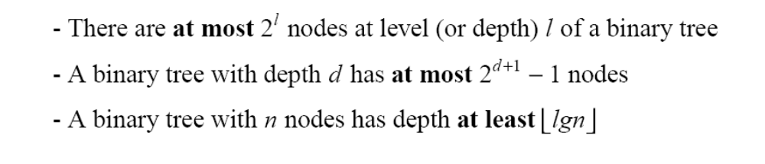
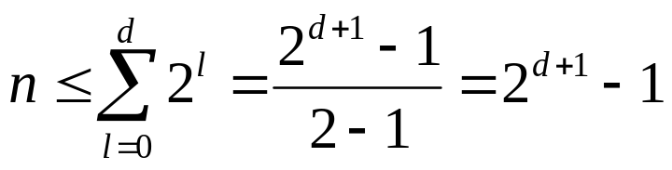
Useful Properties
height
height
4
Height of root = 3
1
3
Height of (2)= 1
2
16
9
10
Level of (10)= 2
14
8

Slide 5
The Heap Data Structure
Def: A heap is a nearly complete binary tree with the following two properties:
  Structural property: all levels are full, except possibly the last one, which is filled from left to right
  Order (heap) property: for any node x
  Parent(x) ≥ x
From the heap property, it follows that:
“The root is the maximum
element of the heap!”
8
7
4
5
2
Heap
A heap is a binary tree that is filled in order

Slide 6
What is a Heap?
A heap is also known as a priority queue and can be represented by a binary tree with the following properties:
Structure property: A heap is a completely filled binary tree with the exception of the bottom row, which is filled from left to right
Heap Order property: For every node x in the heap, the parent of x greater than or equal to the value of x.
(known as a maxHeap).

Slide 7

Example
53
44
25
15
21
13
18
3
12
5
7

Slide 8
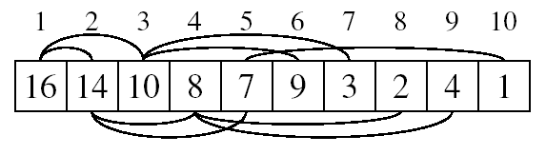
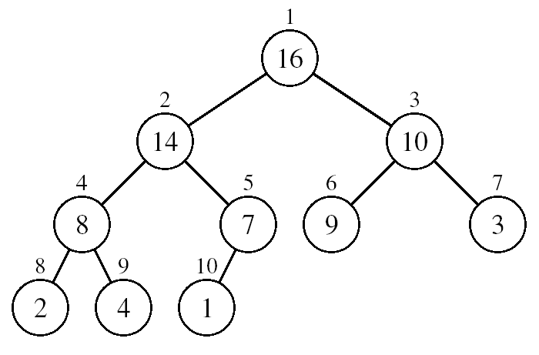
Array Representation of Heaps
A heap can be stored as an array A.
  Root of tree is A[1]
  Left child of A[i] = A[2i]
  Right child of A[i] = A[2i + 1]
  Parent of A[i] = A[ ⎣i/2⎦ ]
  Heapsize[A] ≤ length[A]
The elements in the subarray A[(⎣n/2⎦+1) .. n] are leaves

Slide 9
Heap Types
Max-heaps (largest element at root), have the max-heap property:
  for all nodes i, excluding the root:
  A[PARENT(i)] ≥ A[i]
Min-heaps (smallest element at root), have the min-heap property:
  for all nodes i, excluding the root:
  A[PARENT(i)] ≤ A[i]

Slide 10
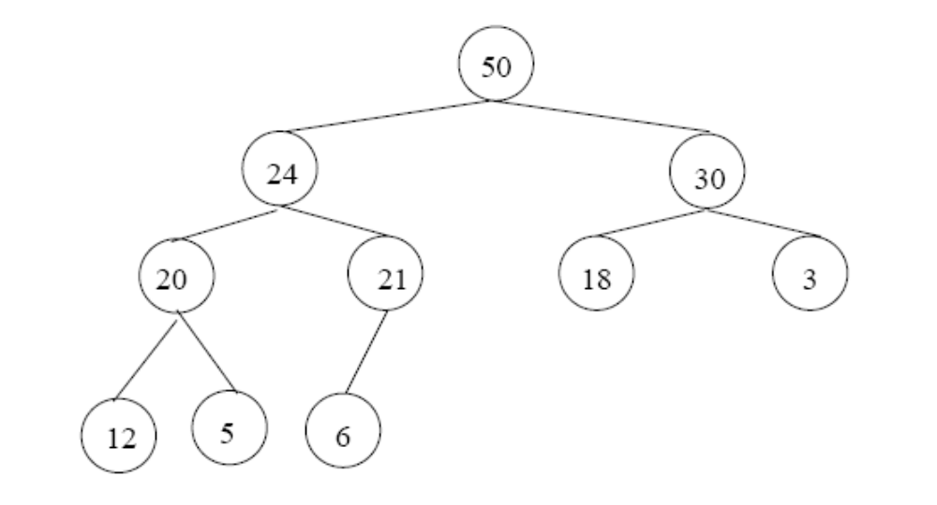
Adding/Deleting Nodes
New nodes are always inserted at the bottom level (left to right)
Nodes are removed from the bottom level (right to left)

Slide 11
Sample Run
Start with unordered array of data
Array representation:
Binary tree representation:
21 | 15 | 25 | 3 | 5 | 12 | 7 | 19 | 45 | 2 | 9
21
15
25
3
5
12
7
19
45
2
9

Slide 12
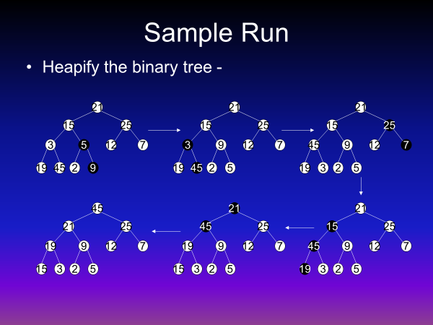
Sample Run
Heapify the binary tree -
21
21
21
15
25
15
25
15
25
3
5
12
7
3
9
12
7
45
9
12
7
19
45
2
9
19
45
2
5
19
3
2
5
45
21
21
21
25
45
25
15
25
19
9
12
7
19
9
12
7
45
9
12
7
15
3
2
5
15
3
2
5
19
3
2
5

Slide 13
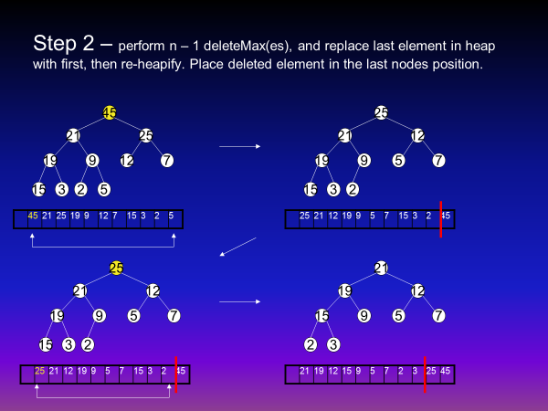

Slide 14
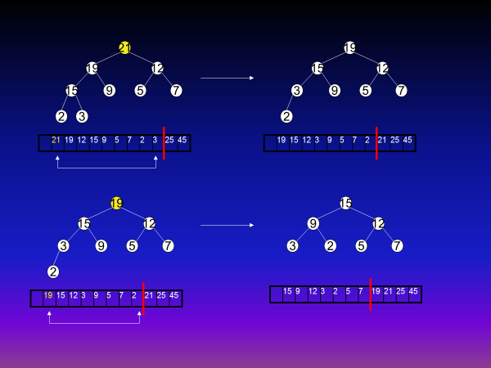

Slide 15
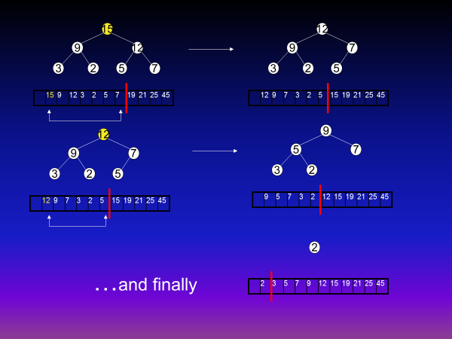

Slide 16
Inserting an element into a heap
Add a new element to the end of an array
Sift up the new element, while heap property is broken. Sifting is done as following: compare node's value with parent's value. If they are in wrong order, swap them.

Slide 17
Operations on Heaps
Maintain/Restore the max-heap property
  MAX-HEAPIFY
Create a max-heap from an unordered array
  BUILD-MAX-HEAP
Sort an array in place
  HEAPSORT
Priority queues

Slide 18
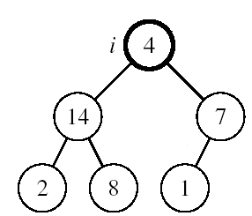
Maintaining the Heap Property
Suppose a node is smaller than a child
  Left and Right subtrees of i are max-heaps
To eliminate the violation:
  Exchange with larger child
  Move down the tree
  Continue until node is not smaller than children

Slide 19
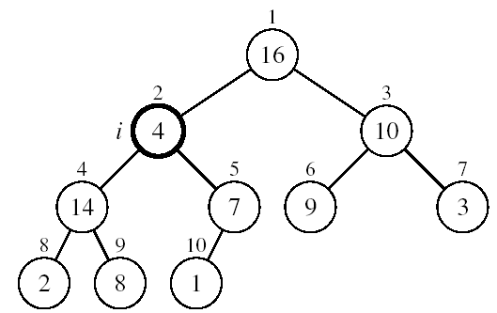
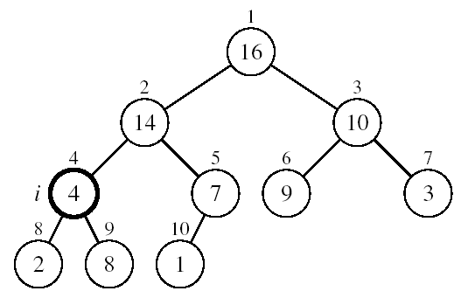
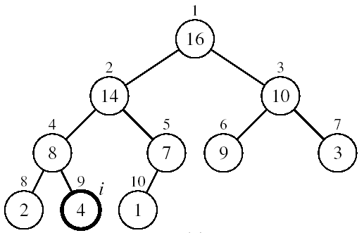
Example
MAX-HEAPIFY(A, 2, 10)
A[2] ↔ A[4]
A[2] violates the heap property
A[4] violates the heap property
A[4] ↔ A[9]
Heap property restored

Slide 20
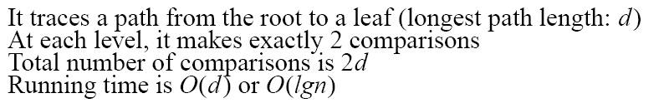
MAX-HEAPIFY Running Time
Intuitively:
Running time of MAX-HEAPIFY is O(lgn)
Can be written in terms of the height of the heap, as being O(h)
  Since the height of the heap is ⎣lgn⎦
-
h
-
-
-
2h
O(h)

Slide 21
Building a Heap
Convert an array A[1 … n] into a max-heap (n = length[A])
The elements in the subarray A[(⎣n/2⎦+1) .. n] are leaves
Apply MAX-HEAPIFY on elements between 1 and ⎣n/2⎦
Alg: BUILD-MAX-HEAP(A)
n = length[A]
for i ← ⎣n/2⎦ downto 1
do MAX-HEAPIFY(A, i, n)
1
4
2
3
1
3
4
5
6
7
2
16
9
10
8
9
10
14
8
7
A:
4 | 1 | 3 | 2 | 16 | 9 | 10 | 14 | 8 | 7

Slide 22
Example: A
4 | 1 | 3 | 2 | 16 | 9 | 10 | 14 | 8 | 7
i = 5
i = 4
i = 3
1
1
1
4
4
4
2
3
2
3
2
3
1
3
1
3
1
3
4
5
6
7
4
5
6
7
4
5
6
7
2
16
9
10
2
16
9
10
14
16
9
10
8
9
10
8
9
10
8
9
10
14
8
7
14
8
7
2
8
7
i = 2
i = 1
1
1
1
4
4
16
2
3
2
3
2
3
1
10
16
10
14
10
4
5
6
7
4
5
6
7
4
5
6
7
14
16
9
3
14
7
9
3
8
7
9
3
8
9
10
8
9
10
8
9
10
2
8
7
2
8
1
2
4
1

Slide 23
Running Time of BUILD MAX HEAP
Alg: BUILD-MAX-HEAP(A)
n = length[A]
for i ← ⎣n/2⎦ downto 1
do MAX-HEAPIFY(A, i, n)
O(n)
O(lgn)
⇒ Running time: O(nlgn)
This is not an asymptotically tight upper bound

Slide 24
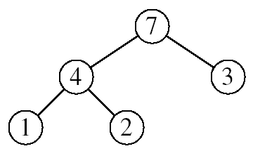
Heapsort
Goal:
  Sort an array using heap representations
Idea:
  Build a max-heap from the array
  Swap the root (the maximum element) with the last element in the array
  “Discard” this last node by decreasing the heap size
  Call MAX-HEAPIFY on the new root
  Repeat this process until only one node remains

Slide 25
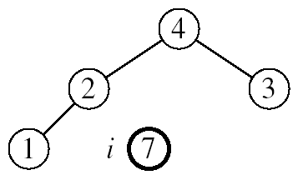
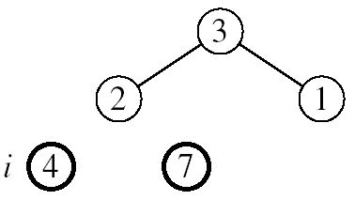
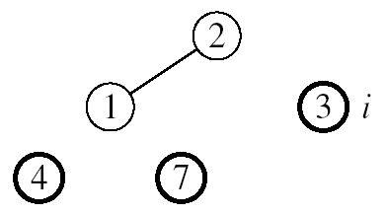
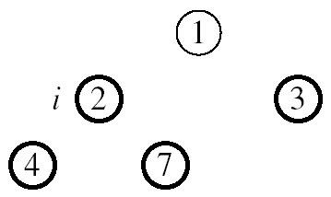

Example: A=[7, 4, 3, 1, 2]
MAX-HEAPIFY(A, 1, 4)
MAX-HEAPIFY(A, 1, 3)
MAX-HEAPIFY(A, 1, 2)
MAX-HEAPIFY(A, 1, 1)

Slide 26
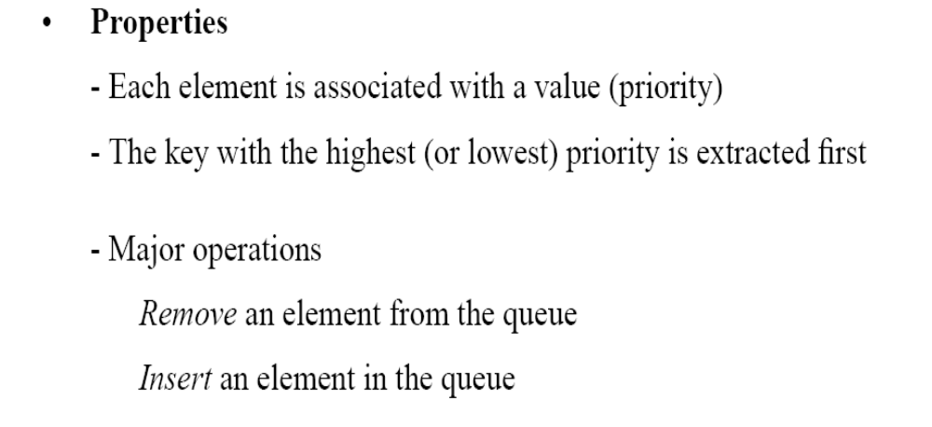
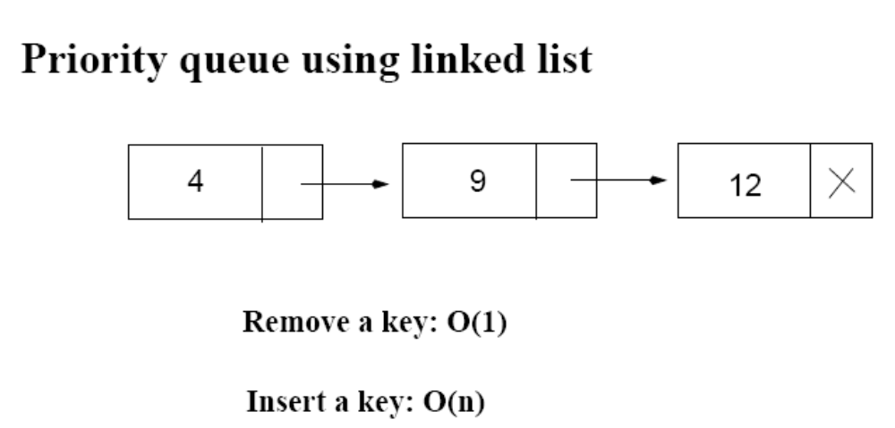
Priority Queues
12
4

Slide 27
Operations on Priority Queues
Max-priority queues support the following operations:
  INSERT(S, x): inserts element x into set S
  EXTRACT-MAX(S): removes and returns element of S with largest key
  MAXIMUM(S): returns element of S with largest key
  INCREASE-KEY(S, x, k): increases value of element x’s key to k (Assume k ≥ x’s current key value)

Slide 28
HEAP-MAXIMUM
Goal:
  Return the largest element of the heap
Alg: HEAP-MAXIMUM(A)
return A[1]
Running time: O(1)
Heap A:
Heap-Maximum(A) returns 7

Slide 29
HEAP-EXTRACT-MAX
Goal:
  Extract the largest element of the heap (i.e., return the max value and also remove that element from the heap
Idea:
  Exchange the root element with the last
  Decrease the size of the heap by 1 element
  Call MAX-HEAPIFY on the new root, on a heap of size n-1
Heap A:
Root is the largest element

Slide 30
Example: HEAP-EXTRACT-MAX
16
1
14
10
max = 16
14
10
8
7
9
3
8
7
9
3
2
4
1
2
4
Heap size decreased with 1
14
Call MAX-HEAPIFY(A, 1, n-1)
8
10
4
7
9
3
2
1

Slide 31
HEAP-EXTRACT-MAX
Alg: HEAP-EXTRACT-MAX(A, n)
if n < 1
then error “heap underflow”
max ← A[1]
A[1] ← A[n]
MAX-HEAPIFY(A, 1, n-1) remakes heap
return max
Running time: O(lgn)

Slide 32
HEAP-INCREASE-KEY
Goal:
  Increases the key of an element i in the heap
Idea:
  Increment the key of A[i] to its new value
  If the max-heap property does not hold anymore: traverse a path toward the root to find the proper place for the newly increased key
16
14
10
8
i
7
9
3
Key [i] ← 15
2
4
1

Slide 33
Example: HEAP-INCREASE-KEY
16
16
14
10
14
10
8
i
7
9
3
8
i
7
9
3
2
4
1
2
15
1
Key [i ] ← 15
16
16
i
14
10
15
10
i
15
7
9
3
14
7
9
3
2
8
1
2
8
1

Slide 34
HEAP-INCREASE-KEY
Alg: HEAP-INCREASE-KEY(A, i, key)
if key < A[i]
then error “new key is smaller than current key”
A[i] ← key
while i > 1 and A[PARENT(i)] < A[i]
do exchange A[i] ↔ A[PARENT(i)]
i ← PARENT(i)
Running time: O(lgn)
16
14
10
8
i
7
9
3
2
4
1
Key [i] ← 15

Slide 35
MAX-HEAP-INSERT
Goal:
  Inserts a new element into a max-heap
Idea:
  Expand the max-heap with a new element whose key is -∞
  Calls HEAP-INCREASE-KEY to set the key of the new node to its correct value and maintain the max-heap property
16
14
10
8
7
9
3
2
4
1
-∞
16
14
10
8
7
9
3
2
4
1
15

Slide 36
Example: MAX-HEAP-INSERT
Insert value 15:
- Start by inserting -∞
Increase the key to 15
Call HEAP-INCREASE-KEY on A[11] = 15
16
16
14
10
14
10
8
7
9
3
8
7
9
3
2
4
1
-∞
2
4
1
15
The restored heap containing
the newly added element
16
16
14
10
15
10
8
15
9
3
8
14
9
3
2
4
1
7
2
4
1
7

Slide 37
MAX-HEAP-INSERT
Alg: MAX-HEAP-INSERT(A, key, n)
heap-size[A] ← n + 1
A[n + 1] ← -∞
HEAP-INCREASE-KEY(A, n + 1, key)
16
14
10
8
7
9
3
2
4
1
-∞
Running time: O(lgn)

Slide 38
Summary
We can perform the following operations on heaps:
  MAX-HEAPIFY O(lgn)
  BUILD-MAX-HEAP O(n)
  HEAP-SORT O(nlgn)
  MAX-HEAP-INSERT O(lgn)
  HEAP-EXTRACT-MAX O(lgn)
  HEAP-INCREASE-KEY O(lgn)
  HEAP-MAXIMUM O(1)
Average
O(lgn)

Slide 39
Priority Queue Using Linked List
12
4
Average: O(n)
Increase key: O(n)
Extract max key: O(1)

Slide 40
Problems
Assuming the data in a max-heap are distinct, what are the possible locations of the second-largest element?

Slide 41
Problems
(a) What is the maximum number of nodes in a max heap of height h?
(b) What is the maximum number of leaves?
(c) What is the maximum number of internal nodes?

Slide 42
Problems
Demonstrate, step by step, the operation of Build-Heap on the array
A=[5, 3, 17, 10, 84, 19, 6, 22, 9]

Slide 43
Problems
Let A be a heap of size n. Give the most efficient algorithm for the following tasks:
Find the sum of all elements
Find the sum of the largest lgn elements

